Slide 1
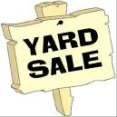
hoLINESS TABERNACLE COGIC COMMUNITY YARD SALE
Kitchenware and gadgets
Clothes
Books
Shoes
Furniture
Electronic Equipment
Toys
AND SO MUCH MORE!!!!
Concession stand will be selling chicken and fish plates along with hamburgers, hot dogs and Baked goods
Corner of Old Bridge and Occoquan Roads
8:00am, Saturday, October 16, 2010
Everything is priced to sell
Holiness Tabernacle 1440 Old Bridge Road Woodbridge, VA

